Slide 1
Programming II
(C Programming Language)
Bit Fields and File Handling in C
Lecture 18, Wednesday April 14, 2021
Dr. Ayman ALJARBOUH

Slide 2
Outline
Bit Fields in C Programming
C File Handling
Creating and Opening Text or Binary Files
Reading from and Writing to Text Files
Reading from and Writing to Binary Files
Bit Field Declaration

Slide 3
Bit Fields in C Programming
In C programming, you can state the size of your structure or union members in the form of bits
This concept is to efficiently utilizing the memory
Bit field can be used to reduce memory consumption when it is known that only some bits would be used for a variable
Bit fields allow efficient packaging of data in the memory

Slide 4
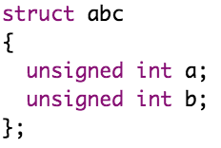
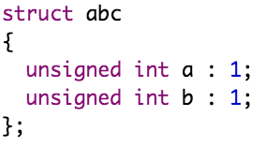
Bit Fields in C Programming
Suppose your C program contains a number of TRUE/FALSE variables grouped in a structure, as follows
You can define the width of a variable which tells the C compiler that you are going to use only those number of bytes
This structure requires 8 bytes of memory space but in actual we are going to store either 0 or 1 in each of the variables
Now, the above structure will require 4 bytes of memory space with only 2 bits will be used to store the values

Slide 5
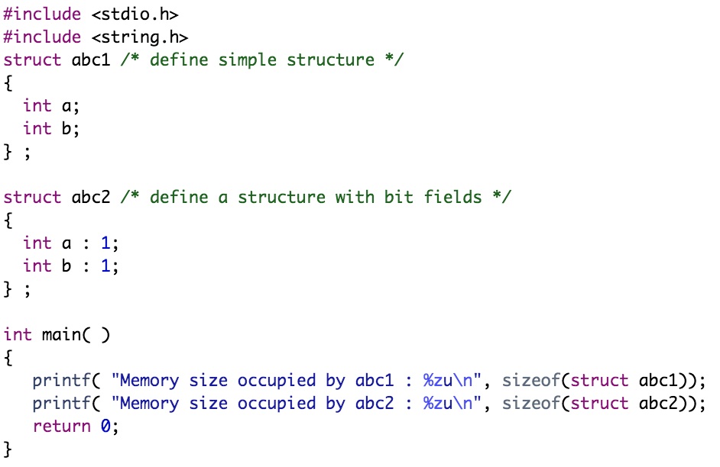
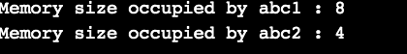
Bit Fields in C Programming
Example:

Slide 6
Outline
Bit Fields in C Programming
C File Handling
Creating and Opening Text or Binary Files
Reading from and Writing to Text Files
Reading from and Writing to Binary Files
Bit Field Declaration

Slide 7
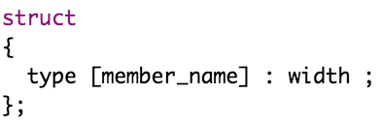
Bit Field Declaration
The declaration of a bit-field has the form inside a structure:
Below the description of variable elements of a bit field:
Element
type | An integer type that determines how the bit-field's value is interpreted. The type may be int, signed int, unsigned int
member_name | The name of the bit-field
width | The number of bits in the bit-field. The width must be less than or equal to the bit width of the specified type

Slide 8
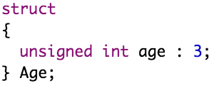
Bit Field Declaration
A bit field can hold more than a single bit
For example, if you need a variable to store a value from 0 to 7 only, then you can define a bit field with a width of 3 bits as follows
The above structure definition instructs C compiler that age variable is going to use only 3 bits to store the value, if you will try to use more than 3 bits then it will not allow you to do so

Slide 9
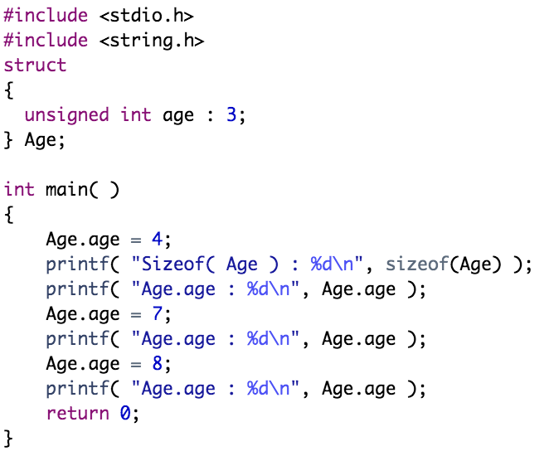
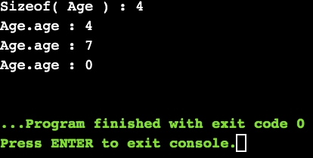
Bit Field Declaration
Example:

Slide 10
Outline
Bit Fields in C Programming
C File Handling
Creating and Opening Text or Binary Files
Reading from and Writing to Text Files
Reading from and Writing to Binary Files
Bit Field Declaration

Slide 11

C File Handling
Why Files Are Needed?
When a program is terminated, the entire data is lost. Storing in a file will preserve your data even if the program terminates
If you have a file containing all the data, you can easily access the contents of the file using a few commands in C
You can easily move your data from one computer to another without any changes
Working with Files
When working with files, you need to declare a pointer of type file. The syntax for declaring a pointer of type file is:

Slide 12
Outline
Bit Fields in C Programming
C File Handling
Creating and Opening Text or Binary Files
Reading from and Writing to Text Files
Reading from and Writing to Binary Files
Bit Field Declaration

Slide 13
Creating and Opening Text or Binary Files
Creating a new file or opening an existing file, whether the file is a text file or binary file, is performed using the fopen() function defined in the stdio.h header file
The syntax for creating a new file or opening an existing file is:
mode can have one of the following values:
Mode | Description
r | Opens an existing text file for reading purpose. If the file does not exist, fopen() returns NULL
w | Opens a text file for writing, if it does not exist then a new file is created
a | Opens a text file for writing in appending mode, if it does not exist then a new file is created. Here your program will start appending content in the existing file content. That is, data is added to the end of the file

Slide 14
Creating and Opening Text or Binary Files
Creating a new file or opening an existing file, whether the file is a text file or binary file, is performed using the fopen() function defined in the stdio.h header file
The syntax for creating a new file or opening an existing file is:
mode can have one of the following values:
Mode | Description
r+ | Opens a text file for reading and writing both. If the file does not exist, fopen() returns NULL
w+ | Opens a text file for reading and writing both. If the file exists, its contents are overwritten. If the file does not exist, it will be created
a+ | Opens a text file for reading and writing both. It creates the file if it does not exist. The reading will start from the beginning but writing can only be appended

Slide 15
Creating and Opening Text or Binary Files
Creating a new file or opening an existing file, whether the file is a text file or binary file, is performed using the fopen() function defined in the stdio.h header file
The syntax for creating a new file or opening an existing file is:
mode can have one of the following values:
Mode | Description
rb | Opens a file for reading in binary mode. If the file does not exist, fopen() returns NULL
wb | Opens a file for writing in binary mode. If it does not exist then a new file is created. Here your program will start writing content from the beginning of the file
ab | Opens a file for append in binary mode, if it does not exist then a new file is created. Your program will start appending content in the existing file content

Slide 16
Creating and Opening Text or Binary Files
Creating a new file or opening an existing file, whether the file is a text file or binary file, is performed using the fopen() function defined in the stdio.h header file
The syntax for creating a new file or opening an existing file is:
mode can have one of the following values:
Mode | Description
rb+ | Opens a file for reading and writing in binary mode. If the file does not exist, fopen() returns NULL
wb+ | Opens a file for reading and writing in binary mode. If the file exists, its contents are overwritten. If the file does not exist, it will be created
ab+ | Opens a file for reading and writing in binary mode. It creates the file if it does not exist. The reading will start from the beginning but writing can only be appended

Slide 17

Closing Files
To close a file, use the fclose() function
The syntax of this function is:
The fclose() function returns zero on success, or EOF if there is an error in closing the file
This function actually, closes the file, and releases any memory used for the file
The EOF is a constant defined in the header file stdio.h

Slide 18
Outline
Bit Fields in C Programming
C File Handling
Creating and Opening Text or Binary Files
Reading from and Writing to Text Files
Reading from and Writing to Binary Files
Bit Field Declaration

Slide 19
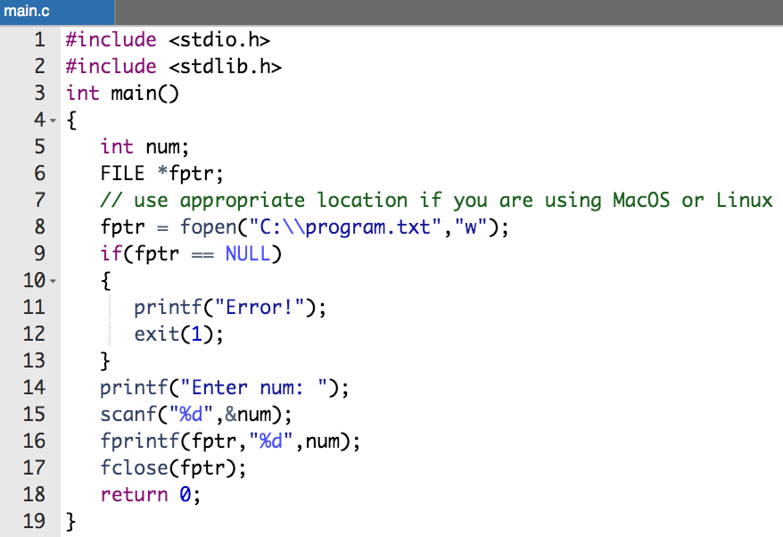
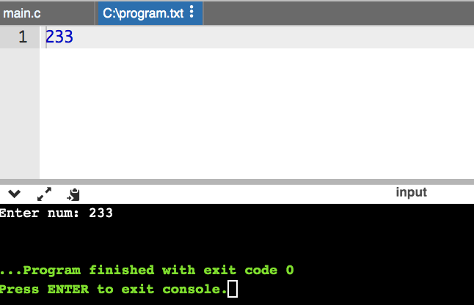
Reading from and Writing to Text Files
For writing to and reading from a text file, we use the functions fprintf() and fscanf(), respectively
Example:
This program takes a number from the user and stores in the file program.txt

Slide 20
Reading from and Writing to Text Files
For writing to and reading from a text file, we use the functions fprintf() and fscanf(), respectively
Example:
We use the function fprintf() to write to a text file

Slide 21
Reading from and Writing to Text Files
For writing to and reading from a text file, we use the functions fprintf() and fscanf(), respectively
Example:
After you compile and run this program, you can see a text file program.txt created in C drive of your computer

Slide 22
Reading from and Writing to Text Files
For writing to and reading from a text file, we use the functions fprintf() and fscanf(), respectively
Example:
When you open the file, you can see the integer you entered

Slide 23
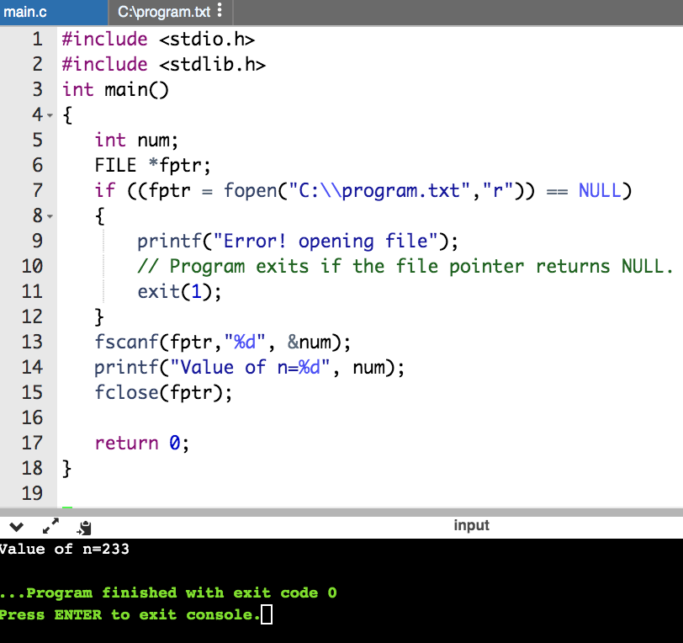
Reading from and Writing to Text Files
For writing to and reading from a text file, we use the functions fprintf() and fscanf(), respectively
Example:
In this program:
We use the function fscanf() to read from a text file.
This program reads the integer present in the program.txt file and prints it onto the screen.
If you successfully created the file from the previous Example, running this program will get you the integer you entered. Other functions like fgetchar(), fputc() etc. can be used in a similar way.

Slide 24
Outline
Bit Fields in C Programming
C File Handling
Creating and Opening Text or Binary Files
Reading from and Writing to Text Files
Reading from and Writing to Binary Files
Bit Field Declaration

Slide 25
Reading from and Writing to Binary Files
Functions fwrite() and fread() are used for writing to and reading from a file on the disk, respectively, in case of binary files
To write into a binary file, you need to use the fwrite() function. The syntax of the fwrite() function is:
The functions take four arguments:
address of data to be written in the disk
size of data to be written in the disk
number of such type of data
pointer to the file where you want to write

Slide 26
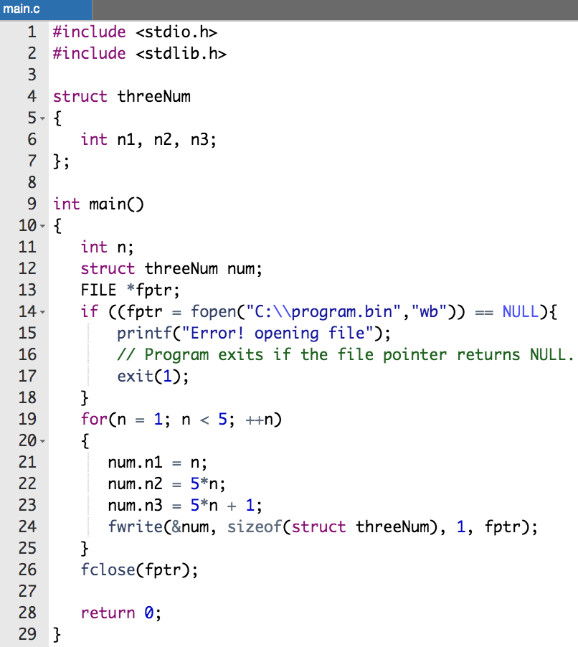
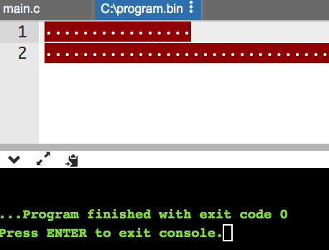
Example:
In this program,
We create a new file program.bin in the C drive
We declare a structure threeNum with three members n1, n2 and n3, and define it in the main function as num
Now, inside the for loop, we store the value into the file using fwrite()

Slide 27
Example:
The first parameter takes the address of num and the second parameter takes the size of the structure threeNum
Since we're only inserting one instance of num, the third parameter is 1. And, the last parameter *fptr points to the file we're storing the data
Finally, we close the file

Slide 28
Reading from and Writing to Binary Files
To read from a binary file, you need to use the fread()function
The syntax of the fread()function is
Function fread() also take 4 arguments similar to the fwrite() function as above

Slide 29
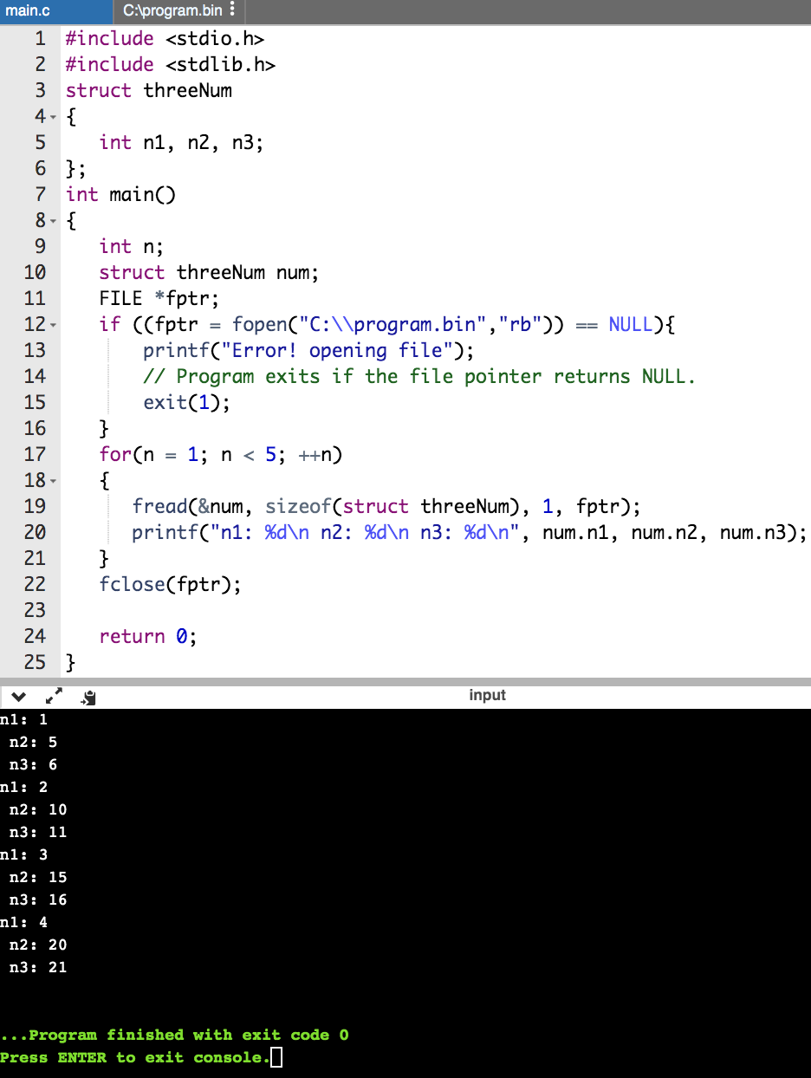
Example:
You read the same file program.bin and loop through the records one by one
In simple terms, you read one threeNum record of threeNum size from the file pointed by *fptr into the structure num
You'll get the same records inserted in the previous Example

Slide 30
Practical Exercises
Write and Compile the following C programs:
Program 1:

Slide 31
Practical Exercises
Write and Compile the following C programs:
Program 2:

Slide 32
Practical Exercises
Write and Compile the following C programs:
Program 3:

Slide 33
Program 4:

